Slide 1

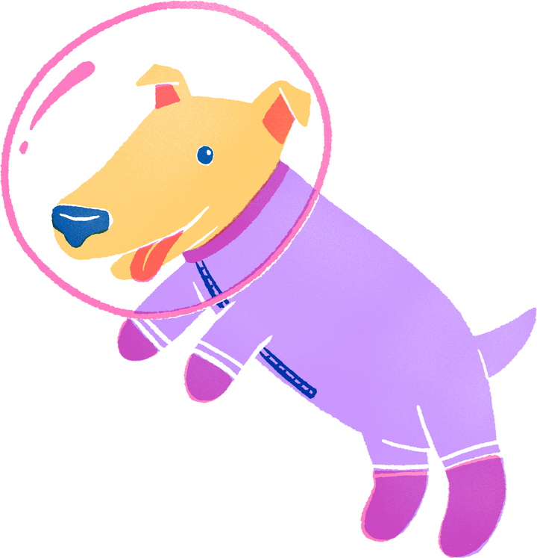
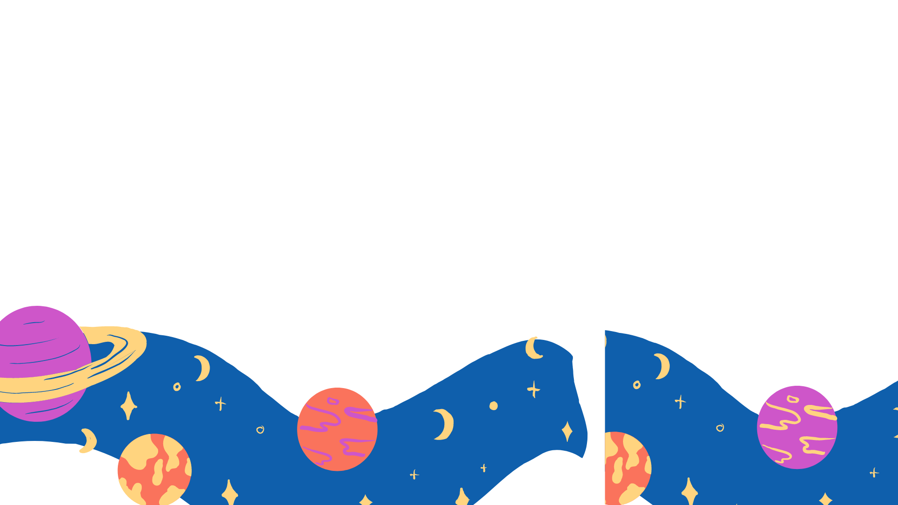
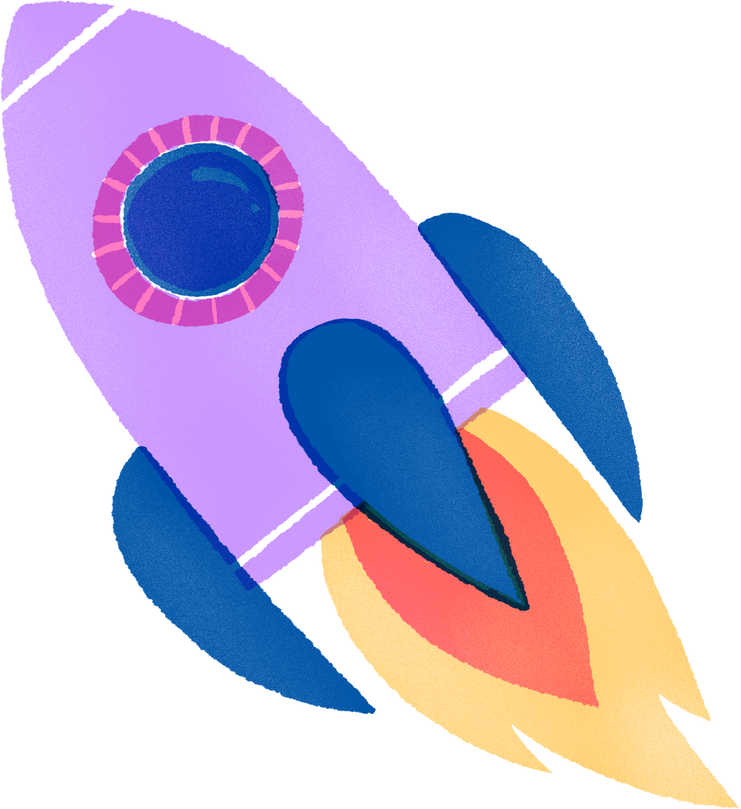
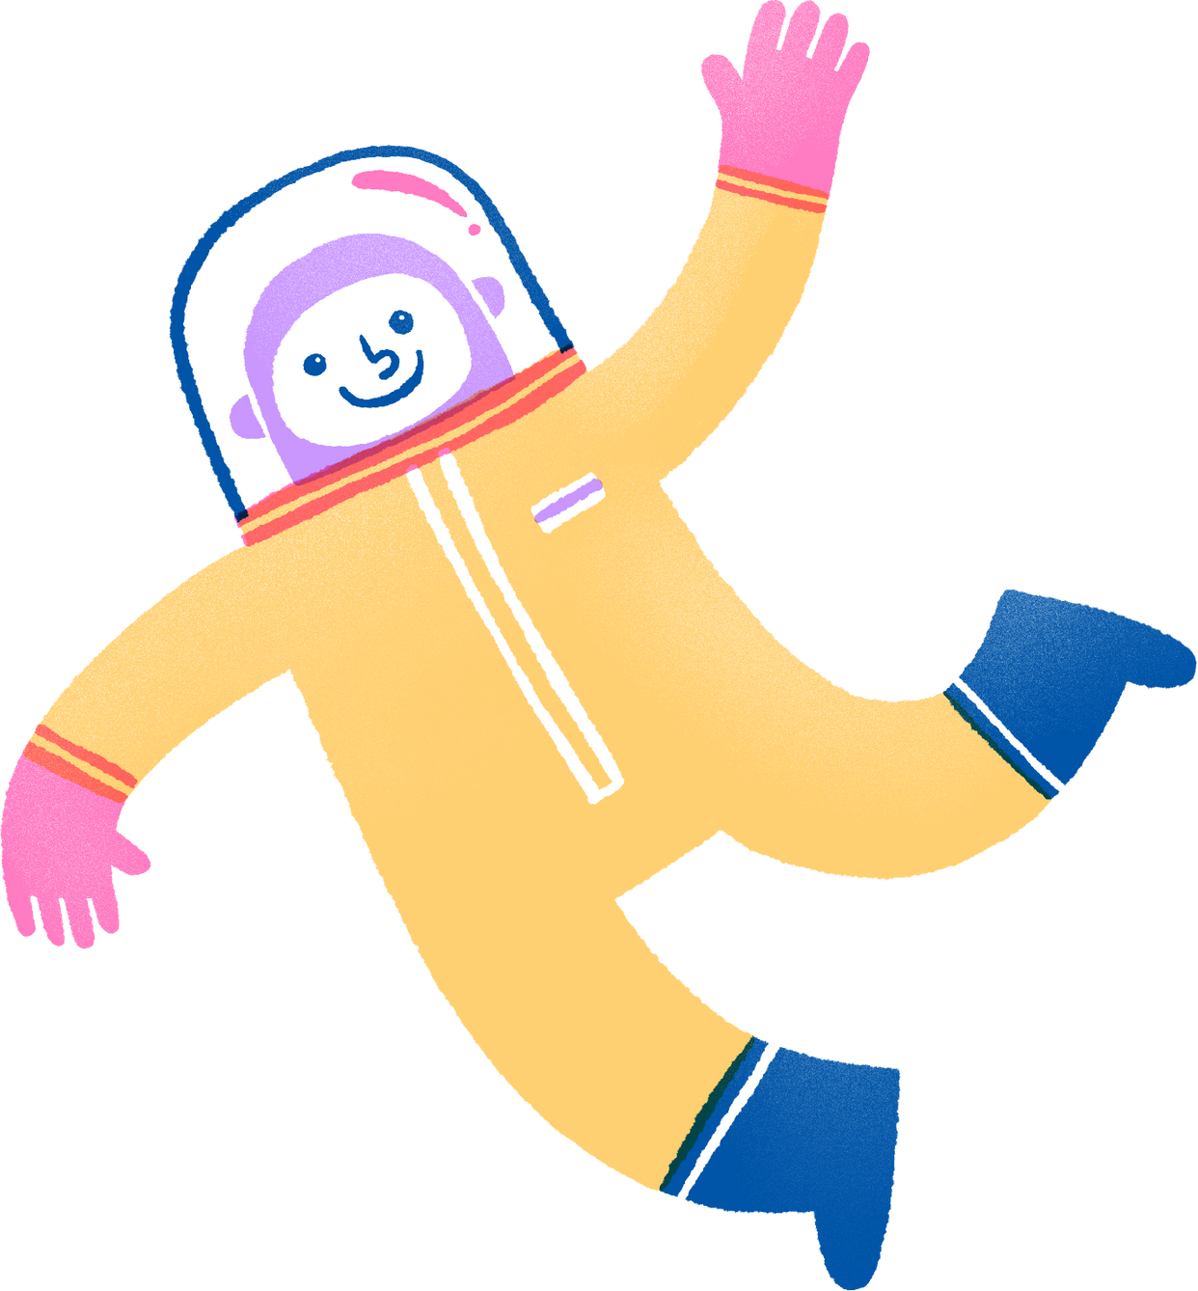

HOW DO TELESCOPES WORK?
HOW DO they unlock the
Secrets of the universe?

Slide 2
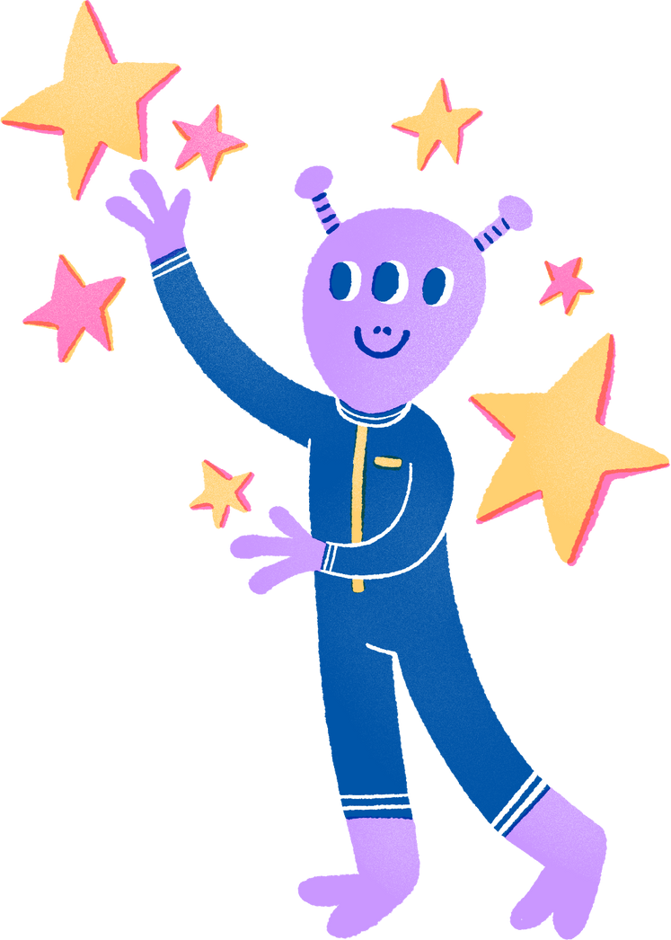


Hello there!
I’m Teja Teppala, an astronomy graduate student at Mizzou!
I study star formation in distant galaxies.

Slide 3


SO, WHO REALLY INVENTED THE TELESCOPE?

Slide 4


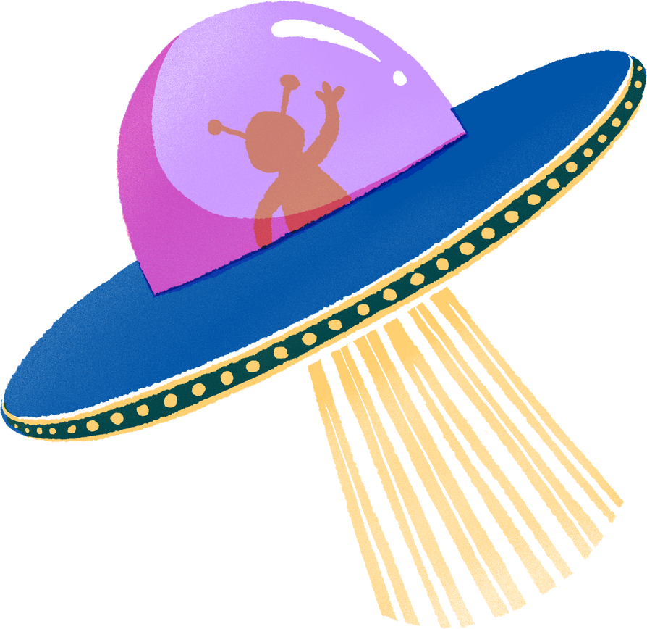
NO,
IT WASN’T GALILEO!

Slide 5
NO,
IT WASN’T GALILEO!
Who was it then?

Slide 6
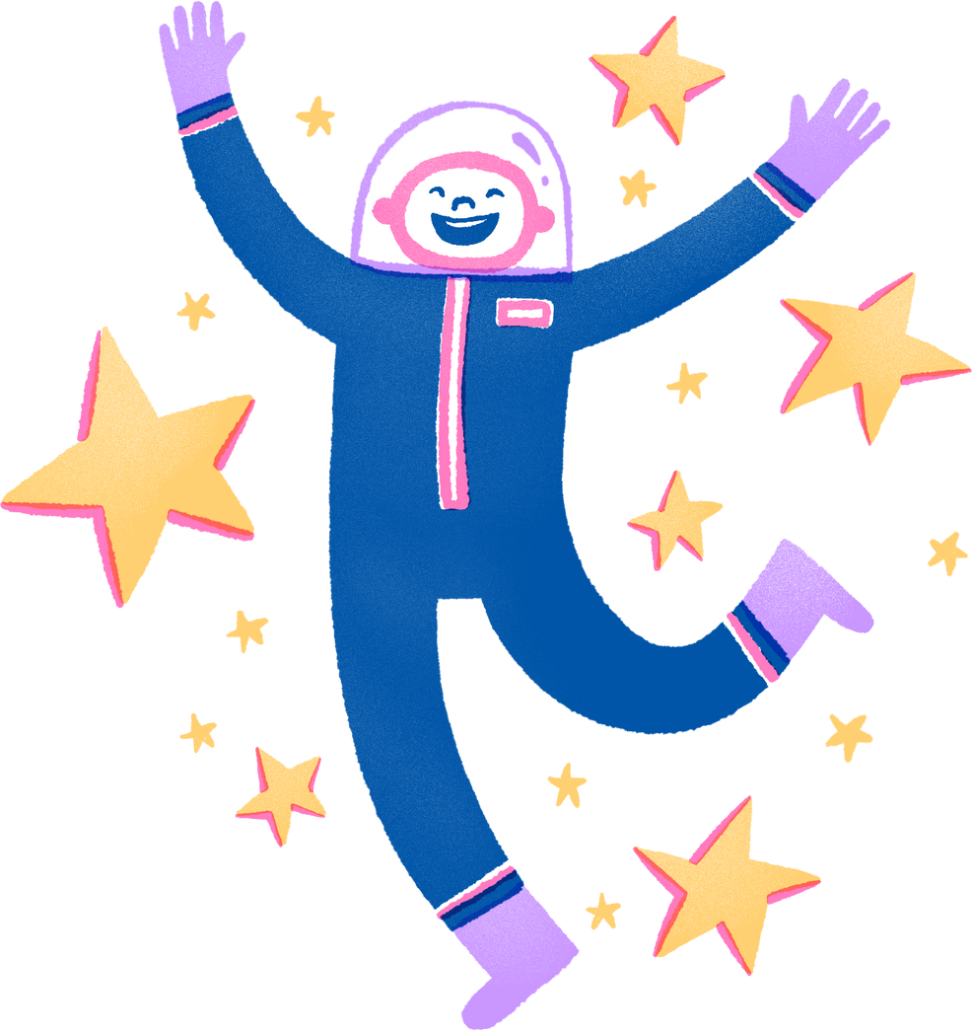
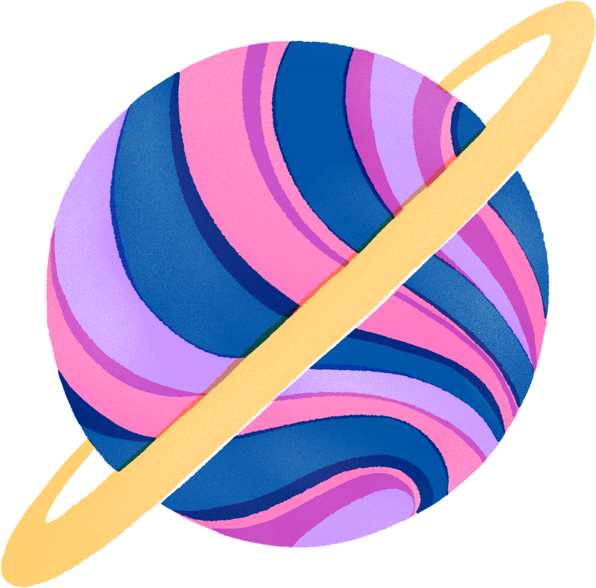
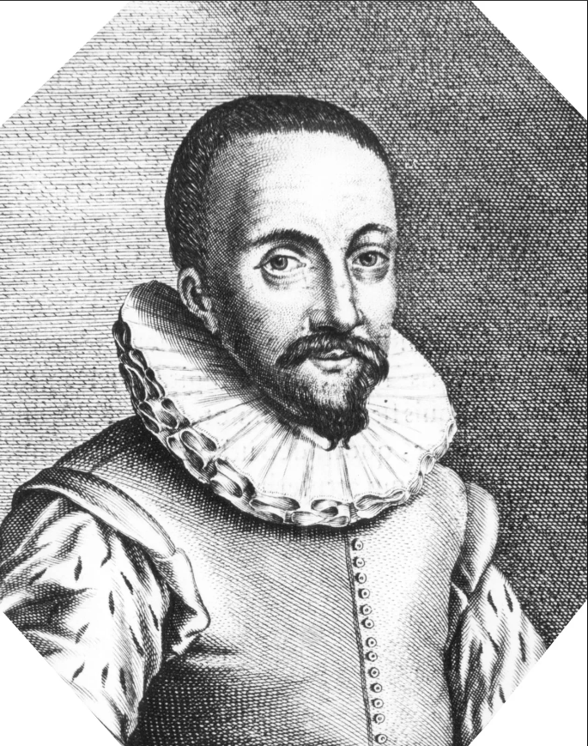
Answer
HANS LIPPERSHEY!

Slide 7
Answer
HANS LIPPERSHEY!
He was a German-Dutch spectacle maker, and was the first inventor to patent the design, in 1608 AD.

Slide 8

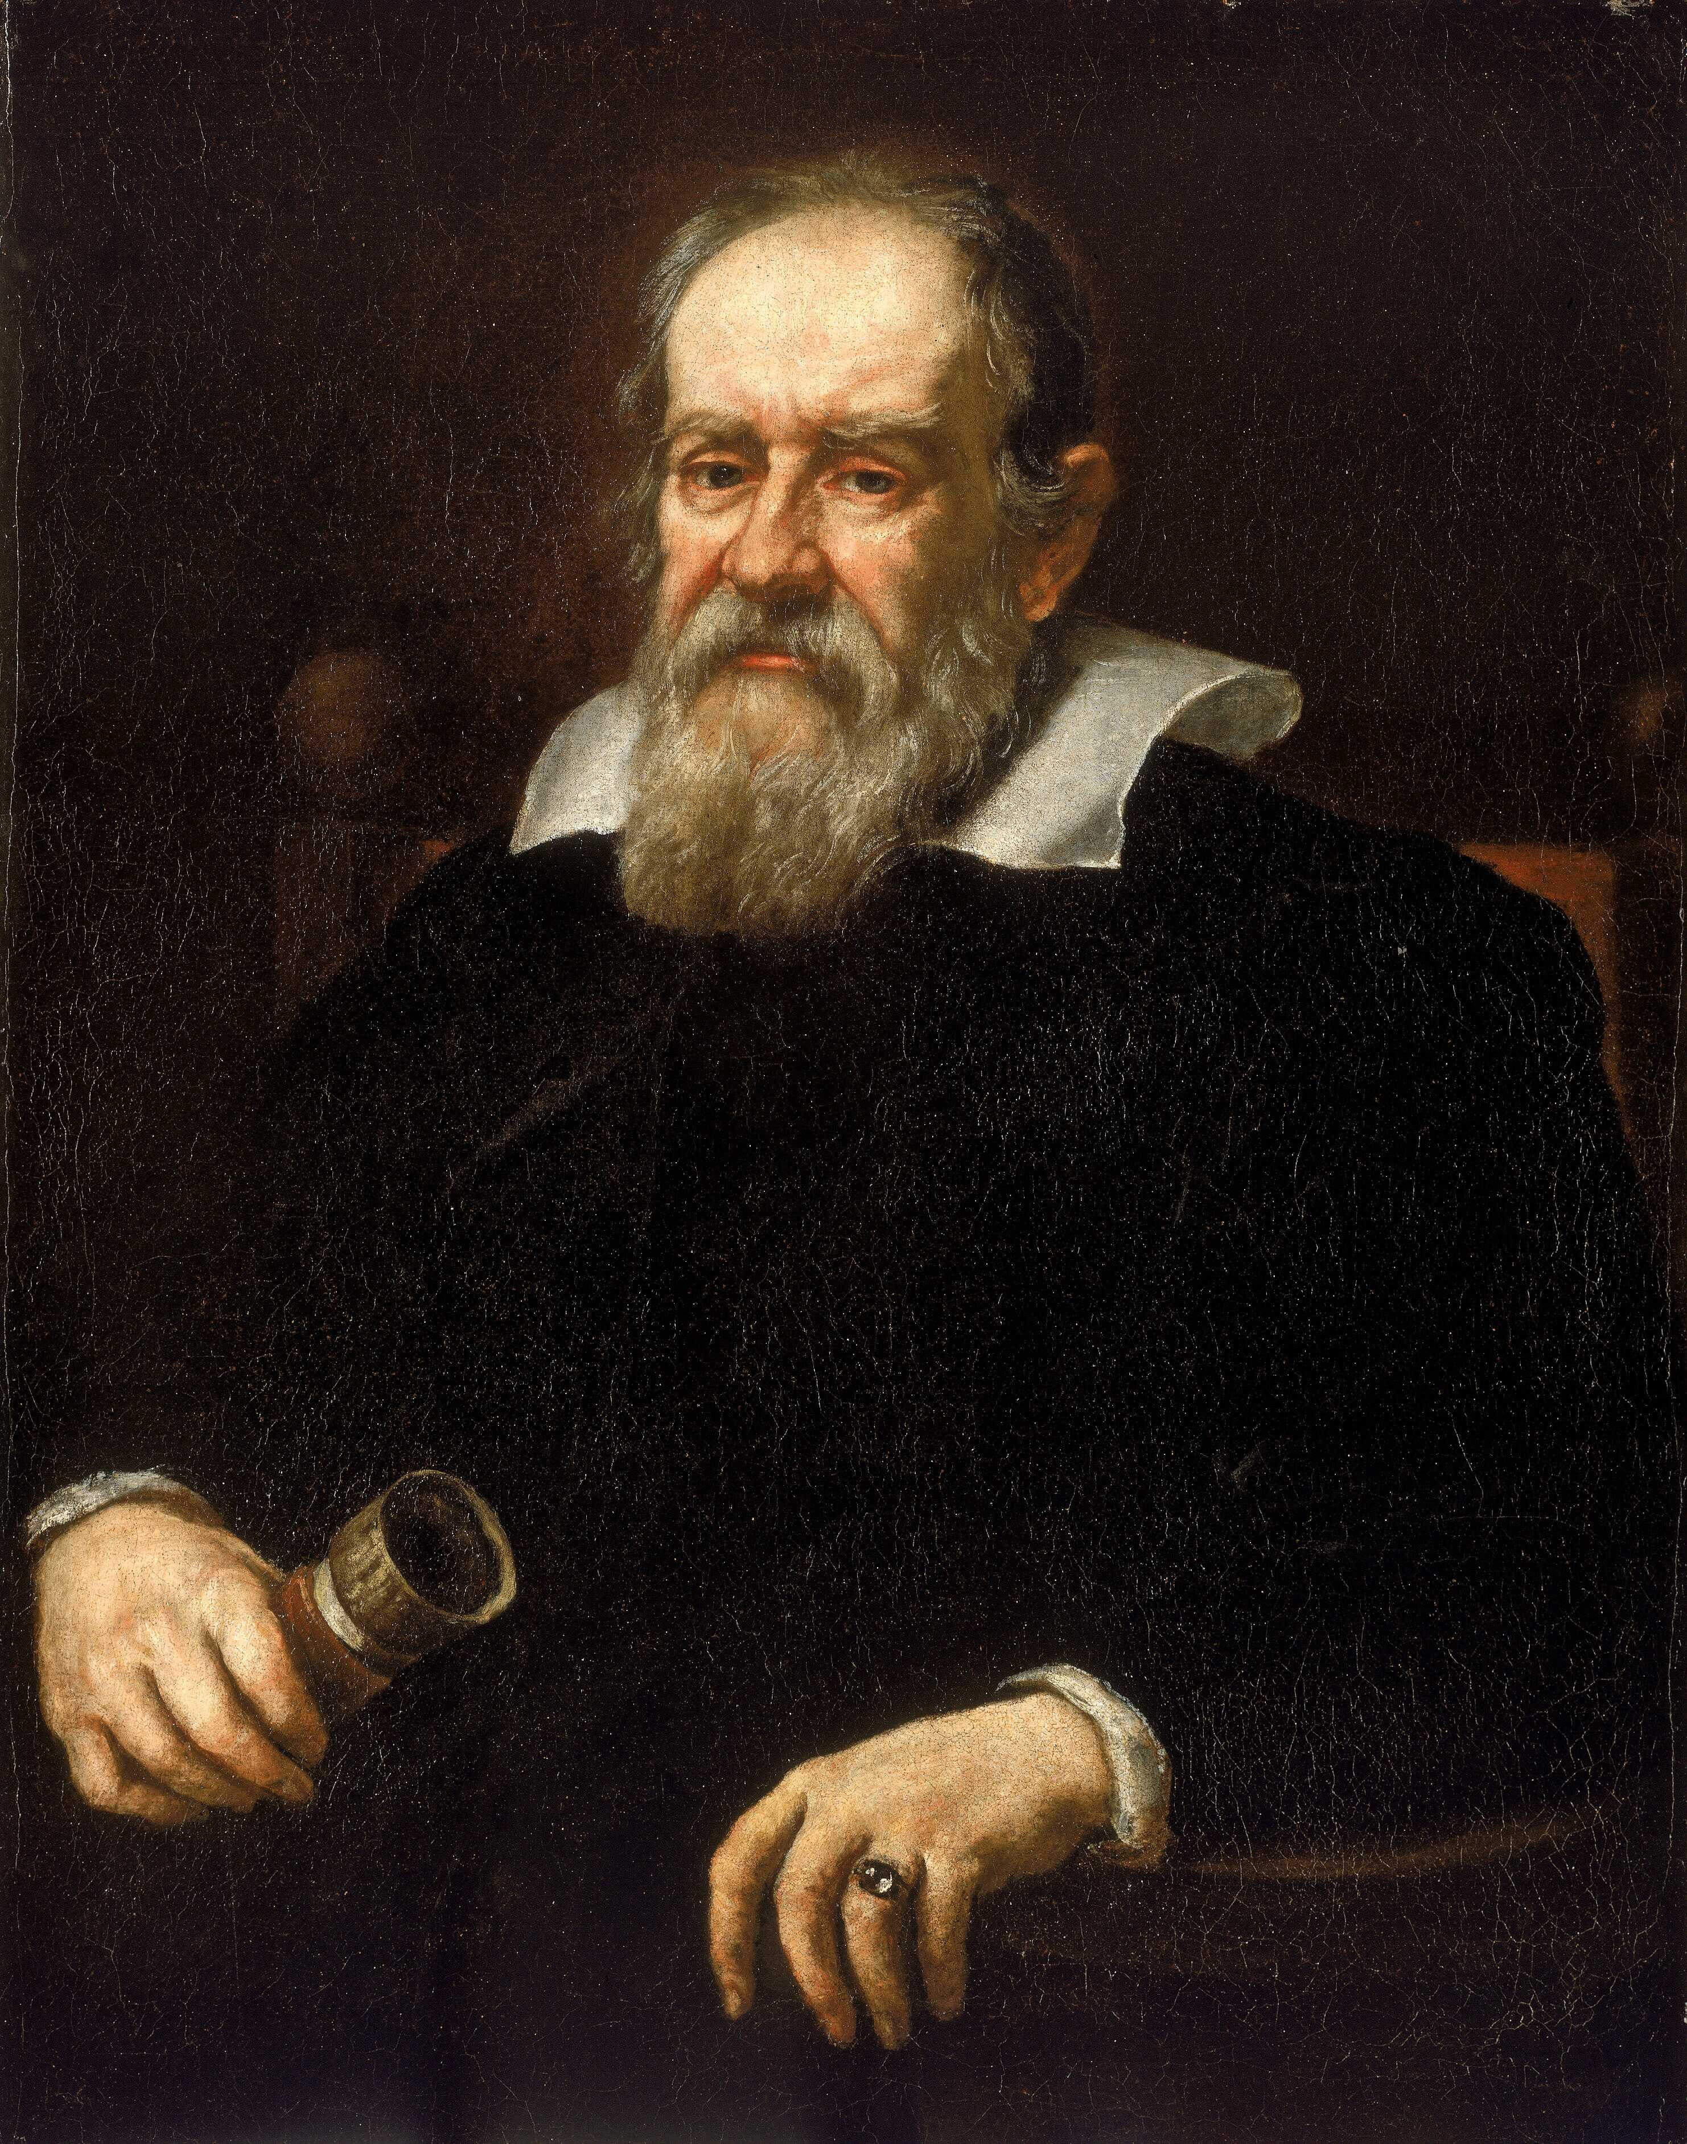
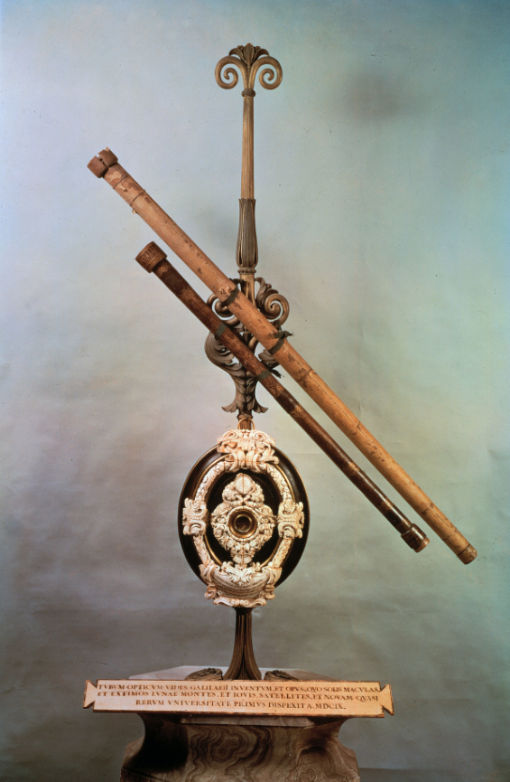
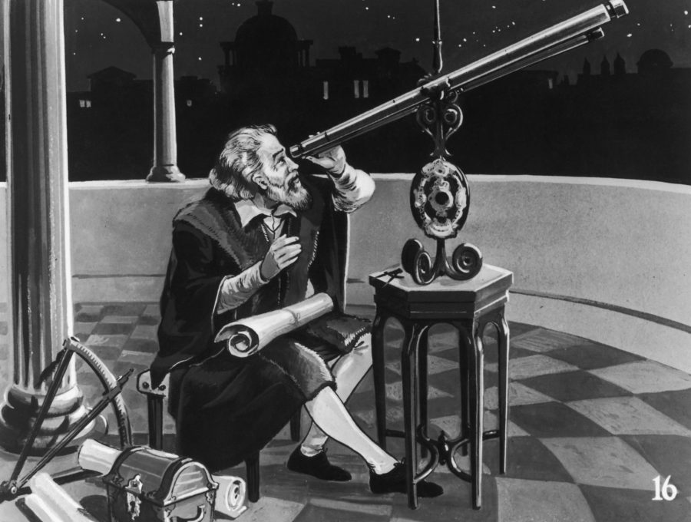
GALILEO WAS THE FIRST TO USE A TELESCOPE FOR ASTRONOMY!

Slide 9
GALILEO WAS THE FIRST TO USE A TELESCOPE FOR ASTRONOMY!
Galileo invented the telescope independently, and was the first to use it for astronomy.

Slide 10

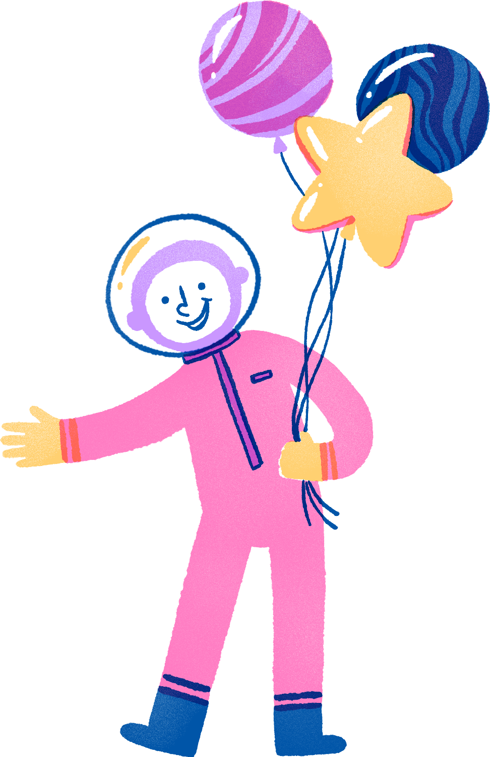
SO, WHAT IS A TELESCOPE?
HOW DOES IT WORK?

Slide 11

Why can’t you see an object that’s far away?

Slide 12
Why can’t you see an object that’s far away?
The object doesn’t take up much space on your eye’s screen!

Slide 13
Why can’t you see an object that’s far away?
The object doesn’t take up much space on your eye’s screen!
For example, you can’t read the writing on a dime which is 100 feet away. So you need to trick your eye into thinking it is closer.

Slide 14
Why can’t you see an object that’s far away?
The object doesn’t take up much space on your eye’s screen!
For example, you can’t read the writing on a dime which is 100 feet away. So you need to trick your eye into thinking it is closer.
A TELESCOPE USES THIS TRICK!

Slide 15
WHAT IS A TELESCOPE?

Slide 16
WHAT IS A TELESCOPE?
THE WORD TELESCOPE COMES FROM THE GREEK WORD TELESKOPOS, WHICH MEANS ‘FAR-SEEING’

Slide 17
WHAT IS A TELESCOPE?
THE WORD TELESCOPE COMES FROM THE GREEK WORD TELESKOPOS, WHICH MEANS ‘FAR-SEEING’
A telescope has two main components:
Objective
Eyepiece

Slide 18

OBJECTIVE

Slide 19
OBJECTIVE
An objective gathers a lot of light from a distant object, and brings that light to a point, or focus.

Slide 20
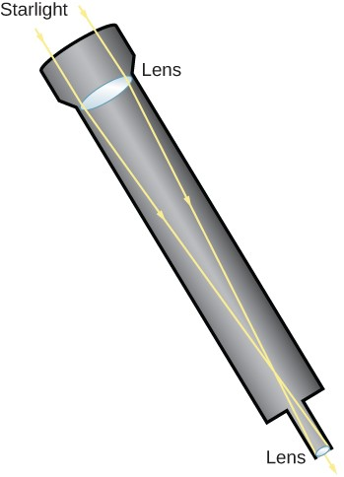
OBJECTIVE
An objective gathers a lot of light from a distant object, and brings that light to a point, or focus.
If the objective is a lens, it is called a REFRACTOR telescope.

Slide 21
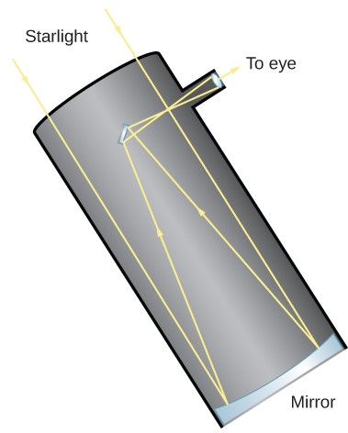
OBJECTIVE
An objective gathers a lot of light from a distant object, and brings that light to a point, or focus.
If the objective is a mirror, it is called a REFLECTOR telescope.

Slide 22
EYEPIECE

Slide 23
EYEPIECE
The eyepiece takes this light at focus, and spreads it out so that it makes a big image on your eye’s screen.

Slide 24
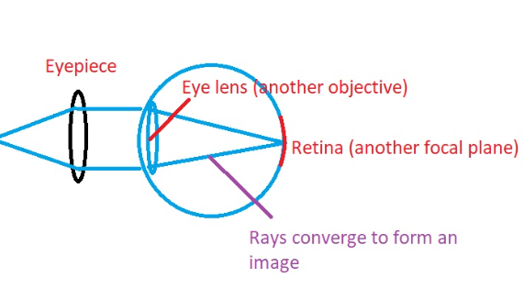
EYEPIECE
The eyepiece takes this light at focus, and spreads it out so that it makes a big image on your eye’s screen.

Slide 25
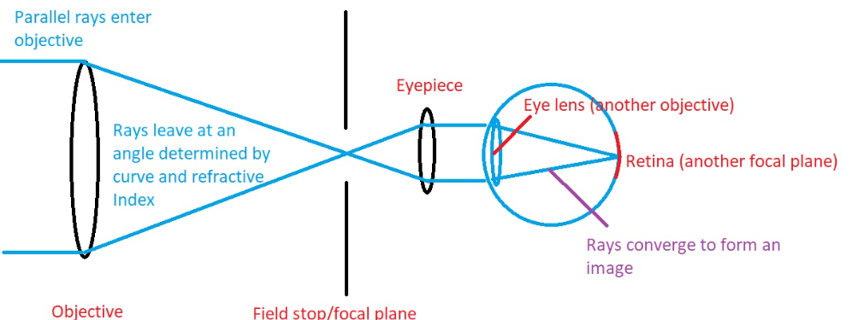
WHEN YOU COMBINE THE OBJECTIVE WITH AN EYEPIECE, YOU HAVE A TELESCOPE!

Slide 26
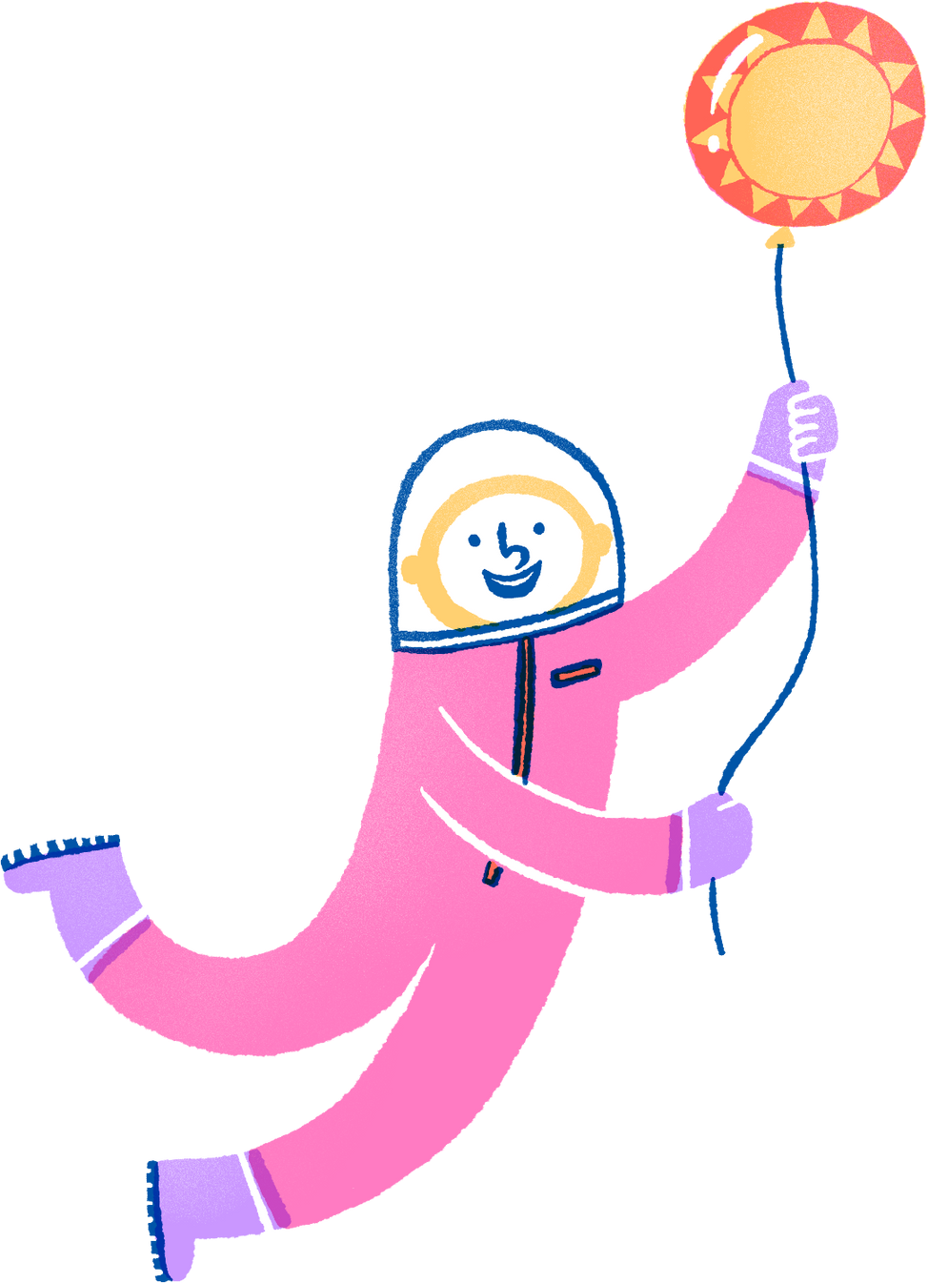
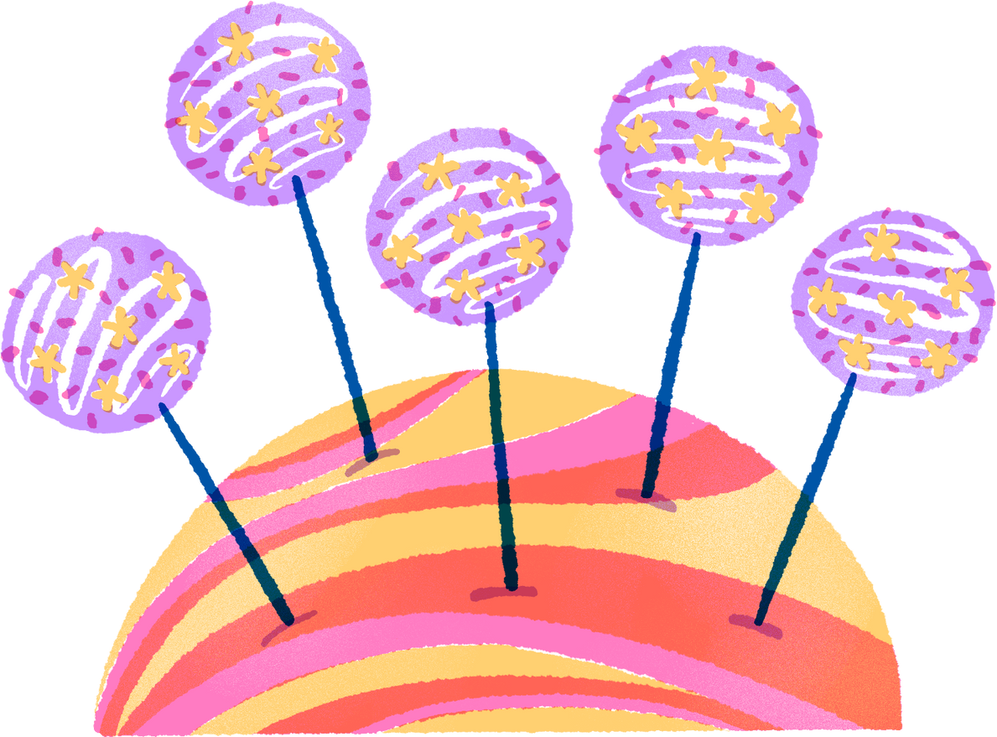
NOW, LET’S SEE THE WORKING OF TELESCOPES
IN ACTION!

Slide 27
NOW, SOME BIG QUESTIONS…

Slide 28
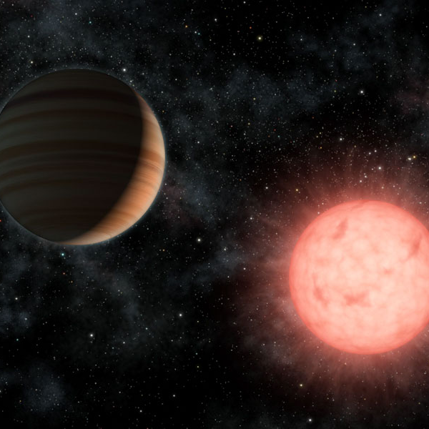
NOW, SOME BIG QUESTIONS…

Slide 29
NOW, SOME BIG QUESTIONS…
Is Earth the center of the universe?

Slide 30
NOW, SOME BIG QUESTIONS…
Is Earth the center of the universe?
How far are the stars? What are they made of?

Slide 31
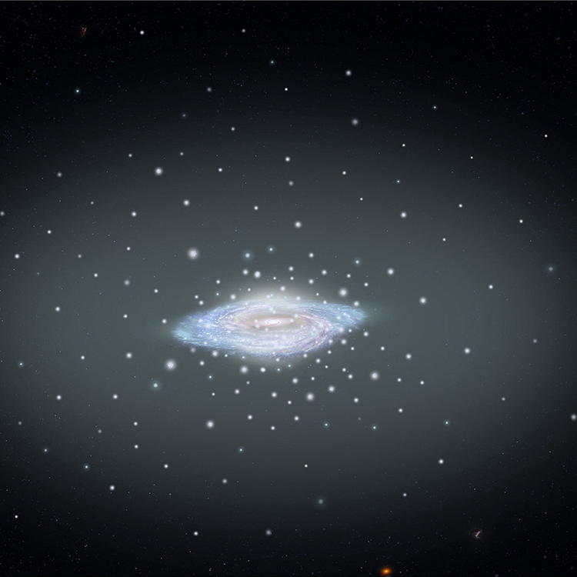
NOW, SOME BIG QUESTIONS…
Is Earth the center of the universe?
How far are the stars? What are they made of?

Slide 32
NOW, SOME BIG QUESTIONS…
Is Earth the center of the universe?
Is the Solar System at the center of the Galaxy?
How far are the stars? What are they made of?

Slide 33
NOW, SOME BIG QUESTIONS…
Is Earth the center of the universe?
Is the Solar System at the center of the Galaxy?
How far are the stars? What are they made of?
Are there planets outside of our solar system?

Slide 34
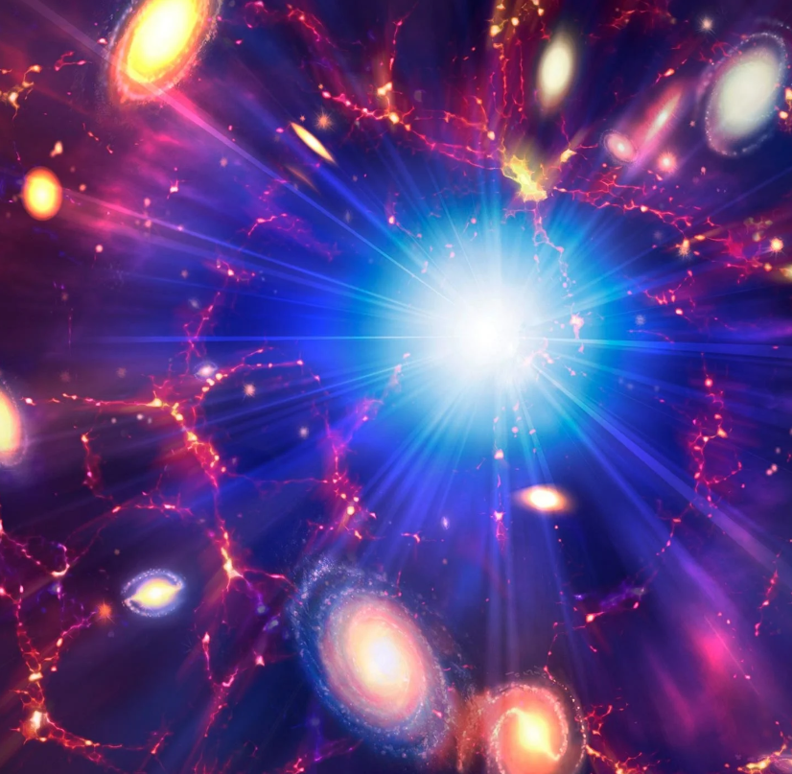
NOW, SOME BIG QUESTIONS…
Is Earth the center of the universe?
Is the Solar System at the center of the Galaxy?
How far are the stars? What are they made of?
Are there planets outside of our solar system?

Slide 35
NOW, SOME BIG QUESTIONS…
Is Earth the center of the universe?
Is the Solar System at the center of the Galaxy?
Are there more galaxies?
How far are the stars? What are they made of?
Are there planets outside of our solar system?

Slide 36
NOW, SOME BIG QUESTIONS…
Is Earth the center of the universe?
Is the Solar System at the center of the Galaxy?
Are there more galaxies?
How far are the stars? What are they made of?
Are there planets outside of our solar system?
How old is the universe?

Slide 37
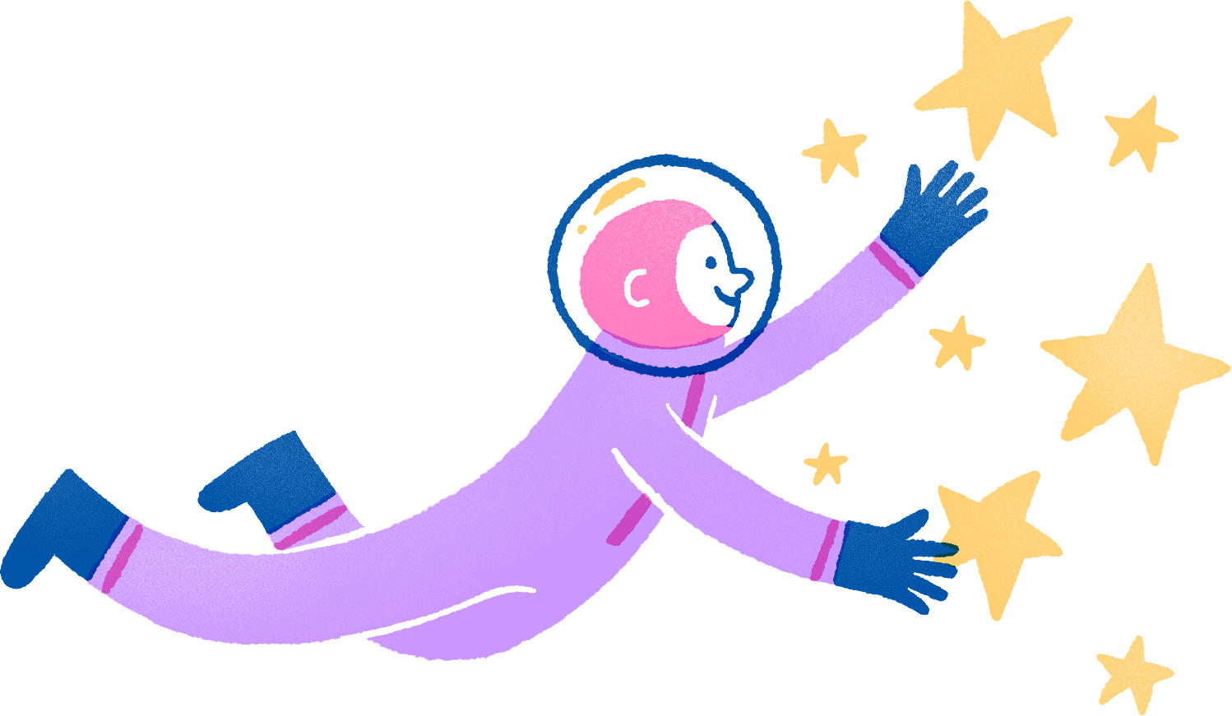
SO HOW DID TELESCOPES HELP ANSWER THESE QUESTIONS?

Slide 38
IS EARTH THE CENTER OF THE UNIVERSE?

Slide 39
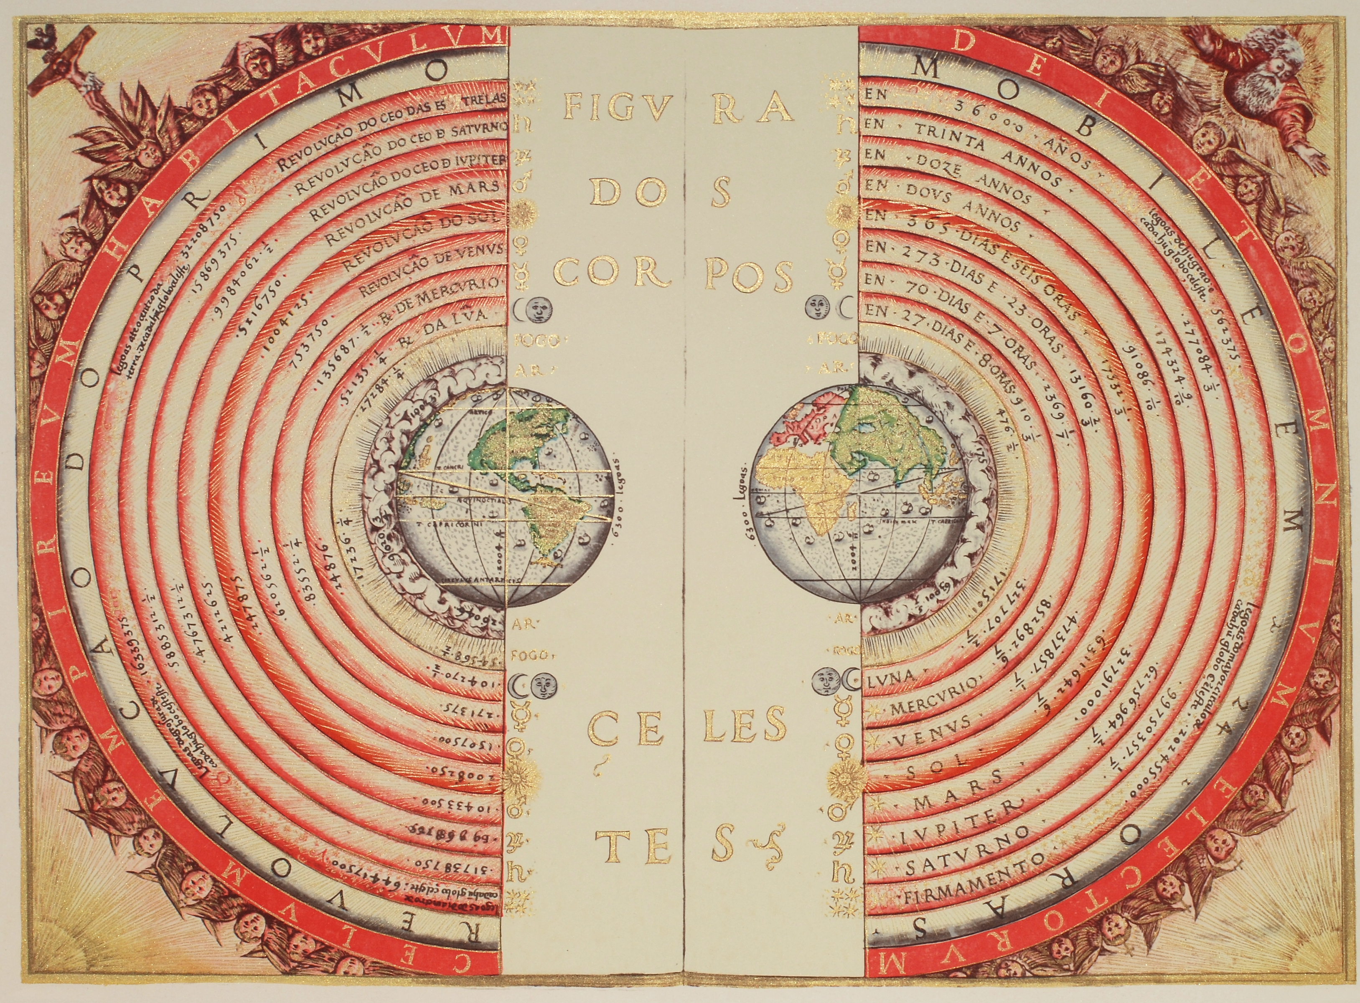
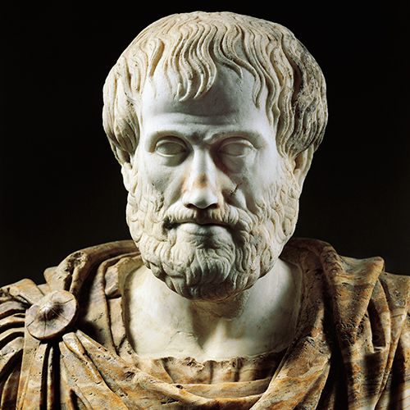
IS EARTH THE CENTER OF THE UNIVERSE?
Aristotle said “Earth”.

Slide 40
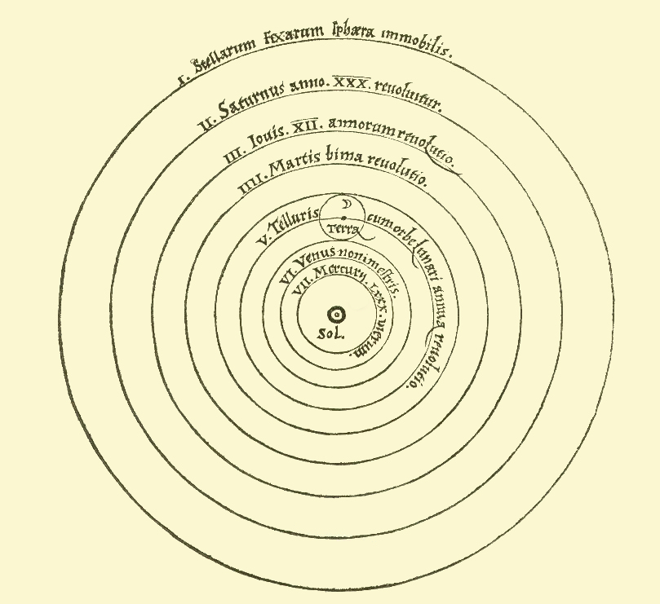
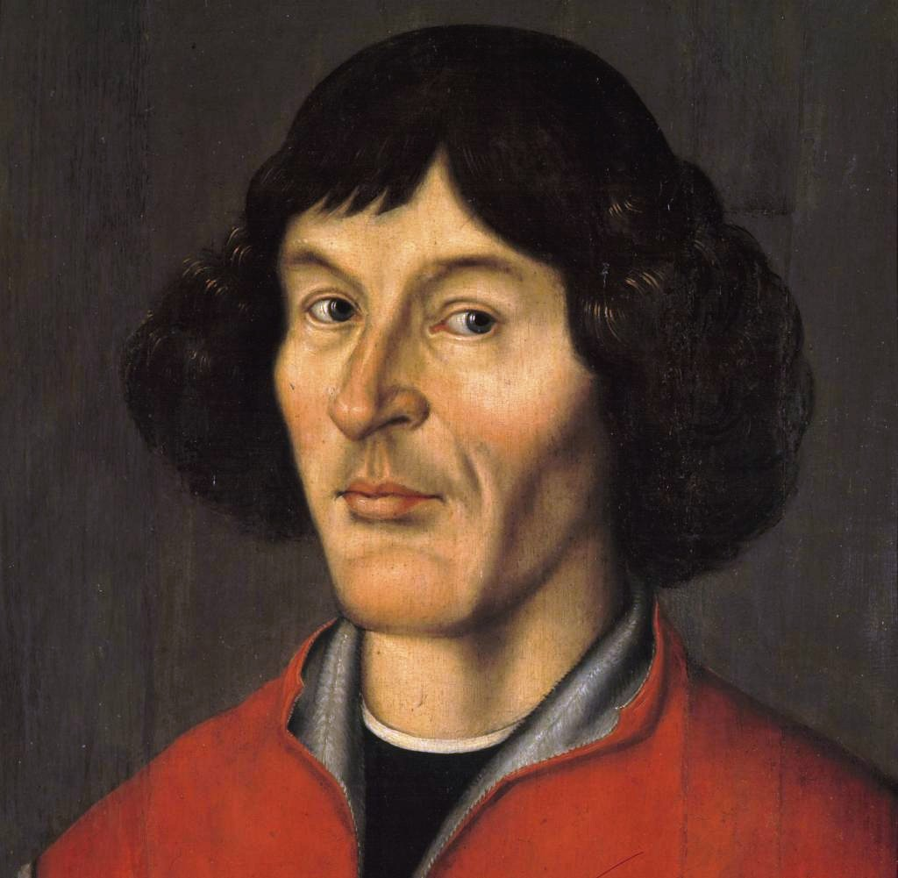
IS EARTH THE CENTER OF THE UNIVERSE?
Copernicus said “Nope, it is the Sun”.

Slide 41
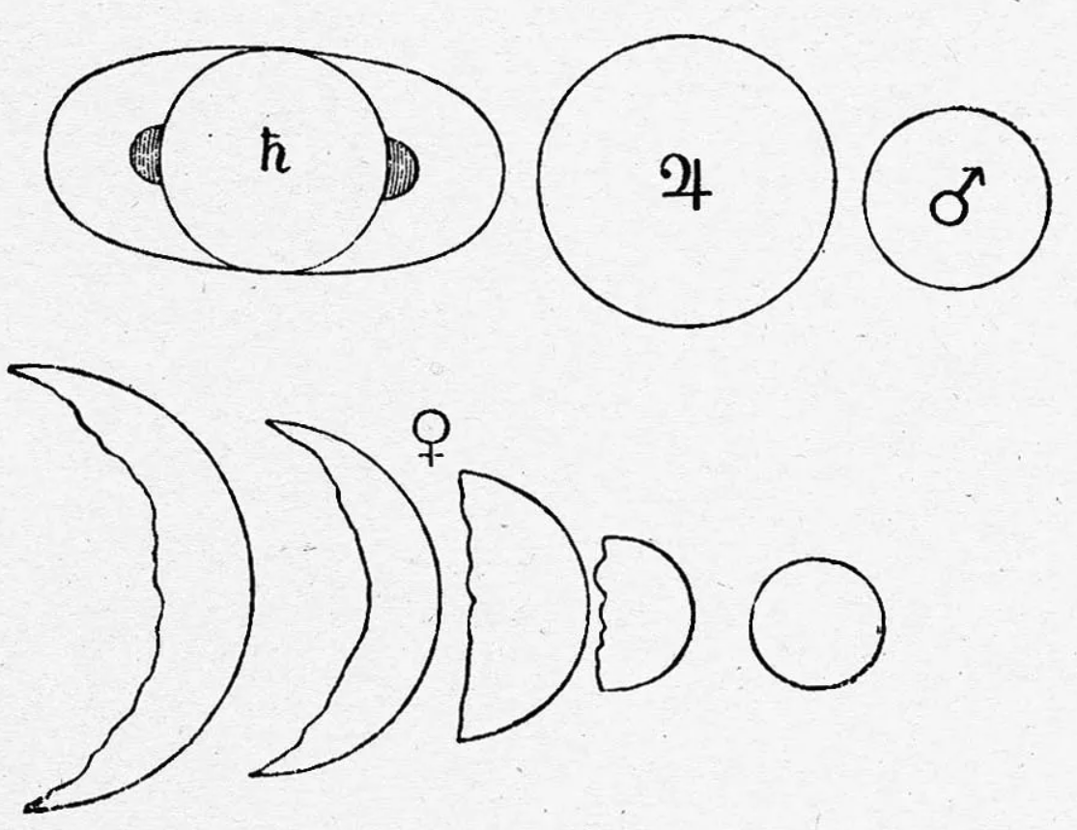
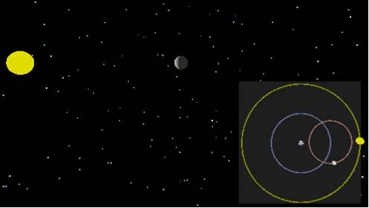
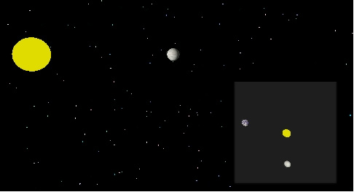
IS EARTH THE CENTER OF THE UNIVERSE?
Galileo observed the phases of Venus with his telescope and determined it is the Sun.

Slide 42
HOW FAR ARE THE STARS? WHAT ARE THEY MADE OF?

Slide 43
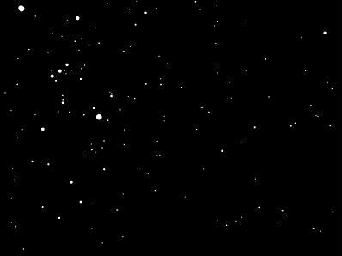
HOW FAR ARE THE STARS? WHAT ARE THEY MADE OF?
We started noticing the positions of stars shifted of the course of an year.

Slide 44
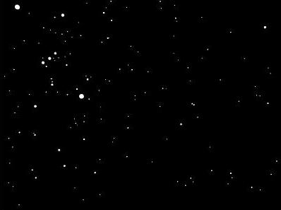
HOW FAR ARE THE STARS? WHAT ARE THEY MADE OF?
We started noticing the positions of stars shifted of the course of an year.
Six months later..

Slide 45
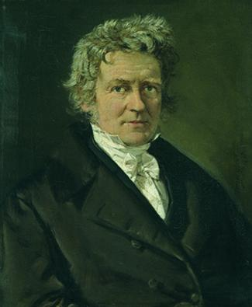
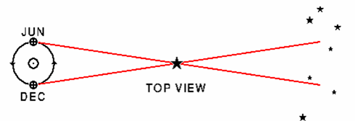
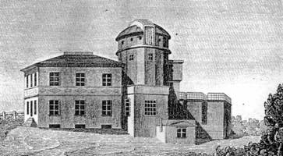
HOW FAR ARE THE STARS? WHAT ARE THEY MADE OF?
Using this difference, Friedrich Wilhelm Bessel measured the accurate distances to the stars using instruments at the Königsberg Observatory.
NOW
6 Months Later

Slide 46
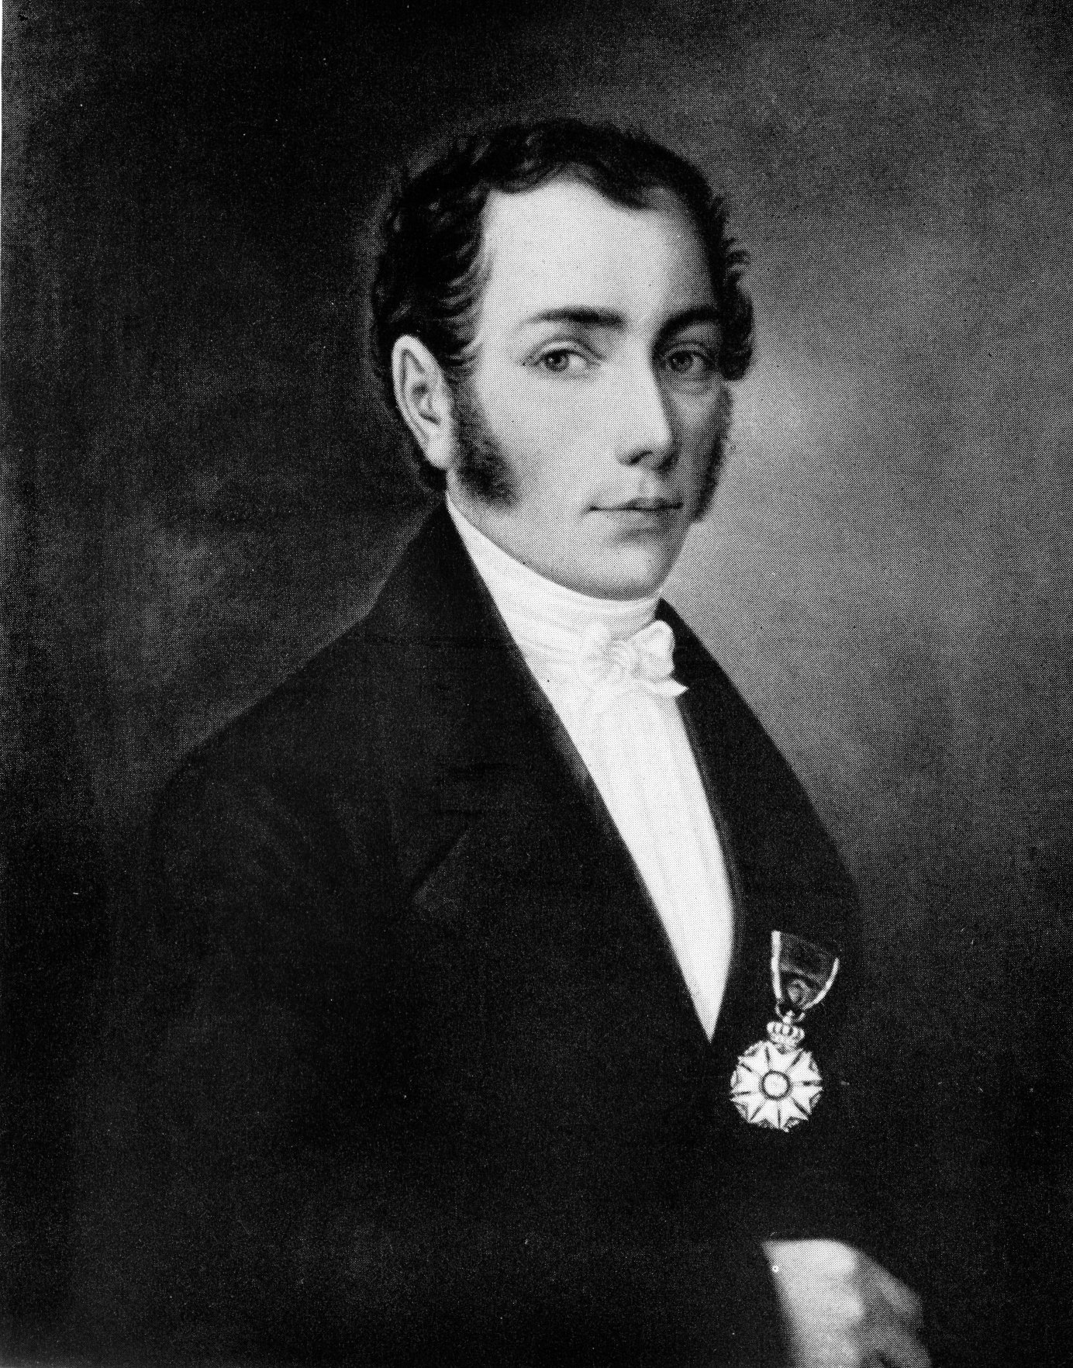
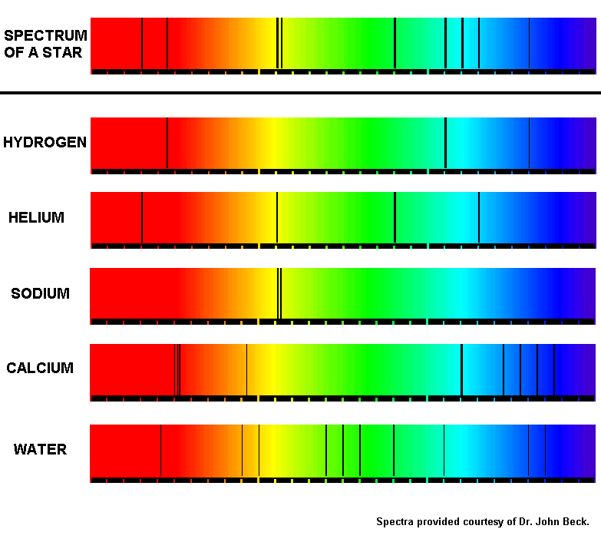
HOW FAR ARE THE STARS? WHAT ARE THEY MADE OF?
Using instruments at the Königsberg Observatory, Joseph von Fraunhofer studied the white light from the Sun, and observed colors like the rainbow, with some dark lines. He called it a spectrum.
Simulated Spectrum of the Sun

Slide 47
HOW FAR ARE THE STARS? WHAT ARE THEY MADE OF?
Those dark lines turned out to be the fingerprints of the elements that made up the atoms of the Sun’s atmosphere!
Soon, the spectra of stars revealed these same dark lines!
Time for a small activity!

Slide 48
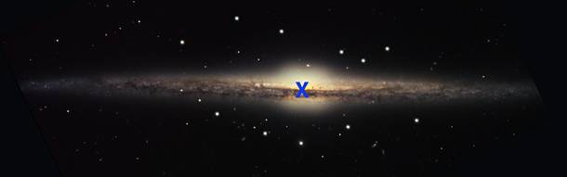
IS SUN THE CENTER OF THE UNIVERSE?
Less than 100 years ago, Sun was thought to be the center of the universe.

Slide 49
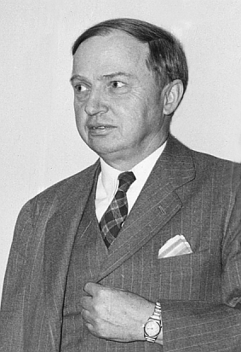
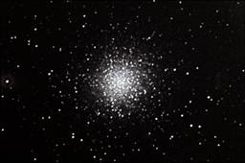
IS SUN THE CENTER OF THE UNIVERSE?
Harlow Shapley, observed bunches of stars called globular clusters, using the 60 inch reflector telescope at the Mount Wilson Observatory.

Slide 50
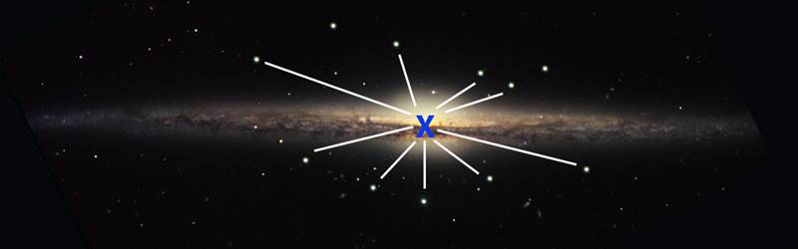
IS SUN THE CENTER OF THE UNIVERSE?
If we were at the center of the galaxy, these star clusters should be randomly distributed in all directions around us. But what did Shapley discover?

Slide 51
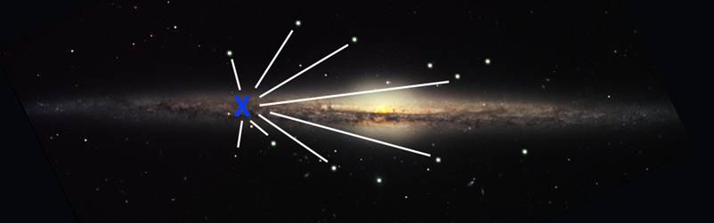
IS SUN THE CENTER OF THE UNIVERSE?
He found clusters to be in a spherical distribution in one direction – toward the constellation of Sagittarius. The location of the center of our galaxy had been determined, and we weren’t there! In fact, the Solar System (the sun and its planets) was far from the center – out in the suburbs!

Slide 52
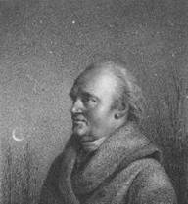
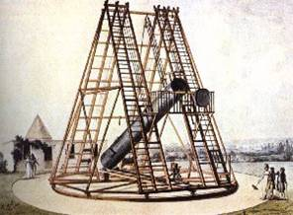
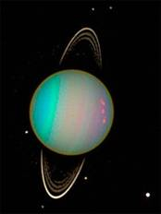
ARE THERE OTHER PLANETS?
Before telescopes, we only knew of 6 planets around the Sun: Mercury, Venus, Earth, Mars, Jupiter, and Saturn.
William Herschel built the largest telescope of his time, 48-inch reflector; he discovered the first planet beyond Saturn: Uranus!
Neptune (and Pluto) were eventually discovered using telescopes.

Slide 53
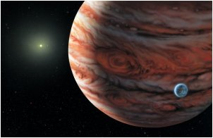
ARE THERE OTHER PLANETS?
Are there any planets beyond the solar system?
Scientists first started finding planets around other stars in our Galaxy in the 1990s.
Since they are so far away, we cannot really ‘see’ them; instead we search for eclipses around stars!

Slide 54
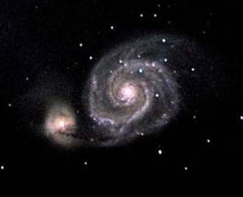
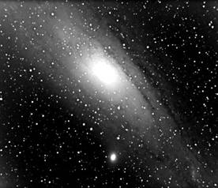
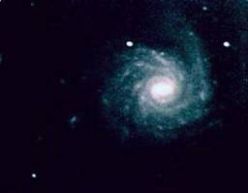
ARE THERE OTHER GALAXIES?
Less than 100 years ago it was still unknown whether our galaxy was the whole universe or just one of many galaxies.
“Spiral nebulae” had been observed and studied since the early 19th century. The term “nebulae” refers to their fuzzy or gaseous appearance. There was variety in their structure or shape that could be documented, but their size was unknown because their distance was unknown.

Slide 55
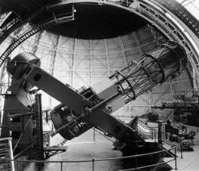


ARE THERE OTHER GALAXIES?
In 1924, Edwin Hubble, using the newly built Mt Wilson 100-inch telescope, estimated the distance to the stars and the nebula in Andromeda galaxy.
The huge distance he measured (2 million light years) meant that Andromeda itself was huge, and a galaxy in its own right.

Slide 56


ARE THERE OTHER GALAXIES?
Suddenly, our Universe was not just the Milky Way galaxy, but a cosmos filled with galaxies!

Slide 57

HOW OLD IS THE UNIVERSE?
Hubble also discovered that these distant galaxies are moving faster away from us!
The universe is expanding!
By measure the rate at which these galaxies are moving, we estimate that the universe started with a Big Bang, 13.6 Billion years ago!

Slide 58


TELESCOPES HAVE CHANGED OUR UNDERSTANDING OF THE UNIVERSE…
Venus
Mars
Mercury
Saturn

Slide 59
ANSWERING BIG QUESTIONS…
Is Earth the center of the universe?
Is the Solar System at the center of the Galaxy?
Are there more galaxies?
How far are the stars? What are they made of?
Are there planets outside of our solar system?
How old is the universe?

Slide 60


changing our understanding of our place in the universe!
From the center of the universe…
… to a very small planet in an immense expanding universe

Slide 61
QUESTIONS?

Slide 62

Thank
you!
Teja Teppala

Slide 63
Answer
A. Hot and poisonous
Venus is surrounded by thick, acidic clouds around 30 miles above its surface.

Slide 64

Answer
A. Jupiter
Jupiter is the largest planet in our solar system, with a diameter of 86,881 miles!

Slide 65
Why can’t you see an object that’s far away?

Slide 66



Quiz Categories
Add a main point
Add a main point
Add a main point
Briefly elaborate on
what you want to discuss.
Briefly elaborate on
what you want to discuss.
Briefly elaborate on
what you want to discuss.

Slide 67

How to Use This Presentation
Google Slides
PowerPoint
Canva
Click on the "Google Slides" button below this presentation preview. Make sure to sign in to your Google account. Click on "Make a copy." Start editing your presentation.
Alternative: Click on the "Share" button on the top right corner in Canva and click on "More" at the bottom of the menu. Enter "Google Drive" in the search bar and click on the GDrive icon to add this design as a Google slide in your GDrive.
Click on the "PowerPoint" button below this presentation preview. Start editing your presentation.
Alternative: From Canva template file, Click on the "Share" button on the top right corner in Canva and click on "More" at the bottom of the menu. Enter "PowerPoint" in the search bar and click on the PowerPoint icon to download.
Click on the "Canva" button under this presentation preview. Start editing your presentation. You need to sign in to your Canva account.

Slide 68
Add an Agenda Page
Section A
Section B
Section C
01
02
03
Describe the topic
of this section.
Describe the topic
of this section.
Describe the topic
of this section.

Slide 69

Write Your Topic or Idea
The Solar System
Planets
The Sun
Briefly elaborate on
what you want to discuss.
Briefly elaborate on
what you want to discuss.
Briefly elaborate on
what you want to discuss.

Slide 70


Question 1
What is the name of the largest planet in our solar system?
A
B
Jupiter
Saturn
C
D
Uranus
Neptune

Slide 71


Multiple Choices
Which of these best describes the atmosphere surrounding Venus?
A
Hot and poisonous
B
Bright and sunny
C
Cold and snowy
D
Cold and wet

Slide 72



Resource
Page
Use these design resources in your Canva Presentation.
Use these design resources in your Canva Presentation.
Titles: Bungee
Headers: Rubik
Body Copy: Rubik
You can find these fonts online too. Happy designing!

Slide 73


Credits
This presentation template is free for everyone to use thanks to the following:
SlidesCarnival for the presentation template
Pexels for the photos
Happy designing!

